Slide 1
Repeating Data and Flow Order
PrintNet T

Slide 2
Context Schema
Workflow
Data Input
&
Manipulation
Document
Design
(Layout)
Impositioning
Approval (Proof)
Spool Production
Notes:
Repeated data is utilized in PrintNet T Layout design.

Slide 3
Agenda
Context
Flow Order

Slide 4

1. Context

Slide 5

Context – Introduction
Answer some important questions before starting to work with variable data:
  What data array will create documents?
  What data array will create sets of pages for each record?
  Which data will be repeated in a table or a flow?
Notes:
Variable data changes from record to record, based on the differences between, e.g., customer credit card purchases. If you are designing a credit card statement, you cannot assume that all customers will need exactly 1 or 2 pages; some customers may require 5 or 6 pages, if they use their credit card a lot.
PrintNet T allows you to repeat certain parts of the Layout design by a particular variable or data array, so that all customers get exactly the number of pages/rows in a table/etc., that they need.

Slide 6

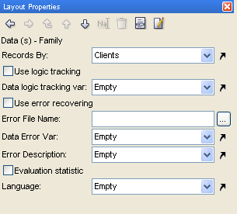

Context – Tutorial
Data must be given context, or variables cannot be recognized.
  Open Context.wfd; open Layout.
  Click on the Data node; Records should be created by Clients.
  Proof your job <F6>.
Notes:
After you have inserted at least one data file, your Data context will be created by the first array by default.

Slide 7
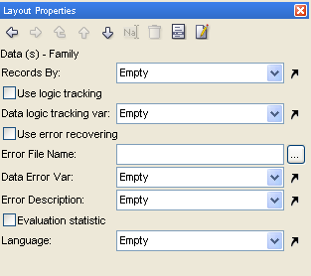


Context – Tutorial
Data must be given context, or variables cannot be recognized.
  In the Data node, choose Empty in the “Records by” combo-box.
  If you proof your job now, you will not have a problem.
  Insert CustName and CustSur variables into the flow area and proof your job again.
  You should receive an error message.
Your variables need context!
Notes:
Data with records created by Empty will not allow the use of any variables in the job.

Slide 8
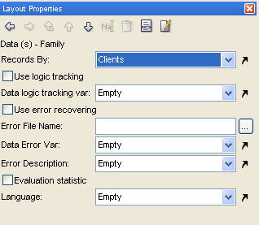

Context – Tutorial
Data must be given context, or variables cannot be recognized.
  Leave the variables in the flow area; choose Clients from the “Records by” combo-box again.
  Proof your job <F6>
  Your variables should appear on the page.
  Check the number of records in your job (100)
Notes:
Your data now has context: the Clients array. There is a page for each record in Clients (100 records in all).

Slide 9
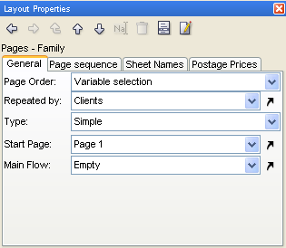
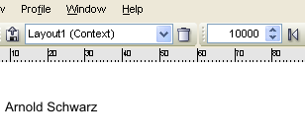
Context – Tutorial
Data must be given context, or variables cannot be recognized.
  Select the Pages node in the Layout tree
  In Layout Properties, make the Page Order “Variable selection” and choose Clients as the “Repeated by” variable.
  Proof your job <F6>
  Check the number of records in your job (10000)
  Scroll through your records; notice how after record 100, they begin again at record 1 (Johannes Planck).
Notes:
With pages repeated by Clients, combined with the data created by Clients, you now have a multiplier effect: there will be 100 pages in the job (one for each record in the data array Clients), and the pages will be repeated 100 times (Repeated by the number of records in Clients)

Slide 10
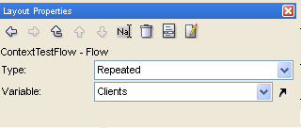

Context – Tutorial
Data must be given context, or variables cannot be recognized.
  Set Records by (in Data node) and Repeated by (in Pages node) both to Empty.
  Click on ContextTestFlow in the Layout Tree; in Layout Properties, change the type to “Repeated” and set Clients as the variable.
  Proof your job <F6>
Notes:
Now the context is not set to the data or the pages, but to the flow itself. The flow will be repeated by all records found in Clients.

Slide 11
2. Flow Order

Slide 12
Flow Order – Introduction
If there is too much repeated data to fit it all into a single flow area:
  Flow order needs to be assigned.
  Any overflowing repeated data will continue into another flow area.

Slide 13

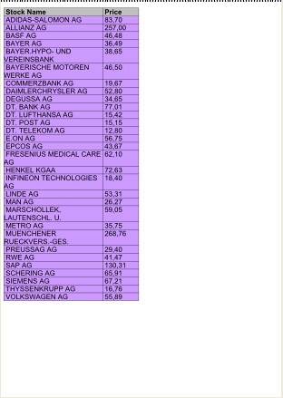
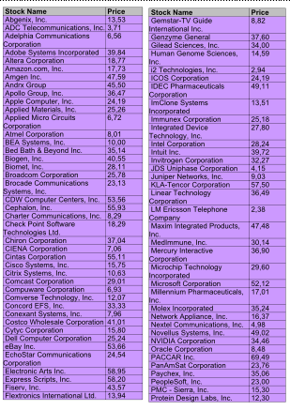
Flow Order – Example
Record 1: Johannes Planck
Record 2: Elizabeth Miles
Notes:
In this example, Elizabeth Miles has more stock holdings than Johannes Planck. She requires a second flow area on the right side of the page to continue her stock listings; however, in designing the job, we need to specify flow order, so that the continued list will begin from where it left off in the first flow area.

Slide 14
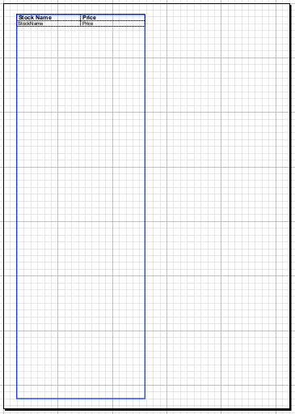
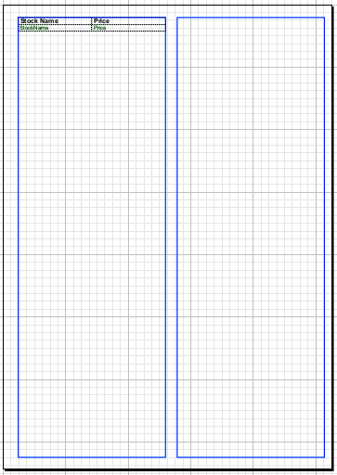
Defining Flow Order
  To define flow order in Layout, first create another flow area that you want your data to flow to.
Create a second flow area

Slide 15
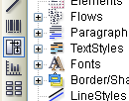
Defining Flow Order
  Select the Flow Order tool from the toolbar.
  Click on the first flow area, and then click on the second flow area.
  A blue arrow will indicate your newly defined flow order.

Slide 16
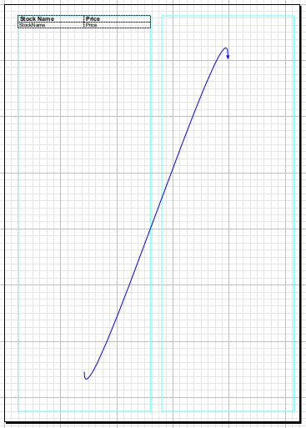
Defining Flow Order – Example
Flow Order tool

Slide 17

Repeating Data and Flow Order – Exercise
Create a basic phone bill by merging two data files, creating a variable table, and defining its flow order.
  Open TelephoneTable.wfd
  Add the appropriate data merging module, so that you can create a sub-array “Items” in the array “Clients”.
  Create two flow areas side-by-side; in the first one insert a table with four columns, one header, and one body row repeated by “Items”
  In the header, type in fixed text headings: Date, Time, Phone Number, Length of Call
  In the body, insert the appropriate variables: Date, Time, DestNo, Minutes
  Use Flow Order tool to redirect any extra table information to the second column
  Proof your job <F6>
Notes:
If you’re having trouble check TelephoneTable_done.wfd for the resolution.
Trainees might notice that there is overflow to another page (which doesn’t exist in our Layout…yet). It will be covered in the next presentation.

Slide 18

Summary
In this presentation we have learned:
  How to:
    Define context for repeated data
    Create a variable, repeated body table
    Define flow order

Slide 19

Discussion
What is the biggest difference between simple tables and repeated tables? Why are repeated tables necessary?
How do you define flow order between flow areas?
Notes:
1. What is the biggest difference between simple tables and repeated tables? Why are repeated tables necessary?
Simple tables have a definite number of body rows; repeated tables don’t have a fixed number of body rows, because their body is defined by a variable which changes from record to record. Repeated tables are necessary because when you merge data files 1-Many, you create a sub-array within a larger array. If you are using a table to list the contents of the sub-array, these contents will vary from record to record in the master array from the first data file (therefore, the table will be of a different size for each record).
2. How do you define flow order between flow areas?
Select the Flow Order tool from the left toolbar; click on the first flow area; click on the second flow area. Your flow order will be shown on the screen by a blue arrow. Can also be set in the Layout Properties of a flow area.

Slide 20

Thank You.
Do You Have Any Questions?

